Slide 1
ANALYTICS USING SQL DATA - DRIVEN ANALYTICS PROJECT PART -1
MENTOR: MUNNA PANDEY
SUBMITTED BY :
M.PRIYANKA

Slide 2
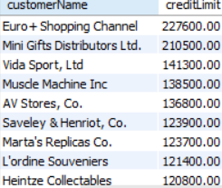
DATA - DRIVEN ANALYTICS PROJECT PART -1
Sprint9 OUTPUT
Find top 10 customers by credit limit.
QUERY: select customerName,creditLimit from customers
order by creditLimit desc
limit 10;
INTERPREATAION: From above query identified the top 10 customers using limit .
Find average credit limit of customer for each country.
QUERY: SELECT country, AVG(creditLimit) AS avgCreditLimit
FROM customers
GROUP BY country
ORDER BY avgCreditLimit;
INTERPRETATION: From above query identified the average credit limit of customer for country wise with the help of aggregate function

Slide 3
Find number of customers in each state.
QUERY: Select state,count(*) as count_for_each_state from customers
group by state;
INTERPRETATION: From that identified the number of customers in each state with the help of count function.
Find customers who haven’t placed any orders.
QUERY: select customerName from customers
where customerNumber not in(select customerNumber from orders);
INTERPRETATION: From that identified the customer who haven’t placed any order with the help of subquery.

Slide 4
Retrieve customer information with their most recent payment details.
QUERY: select customerName,customerNumber,date(paymentDate)
from customers left join payments using(customerNumber)
order by 3 desc;
INTERPRETATION: From that identified the most recent payment details of a customer using order by.
Identify customers who have exceeded their credit limit.
QUERY: SELECT customerNumber,customerName,creditLimit,amount,(amount-creditLimit) as excess
FROM customers join payments using(customerNumber)
having amount > creditlimit
order by customerNumber;
INTERPRETATION: From that identified the customer who exceeded creditlimit.

Slide 5
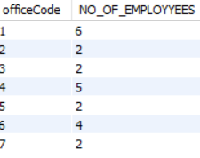
Find the names of all customers who have placed an order for a product from a specific product line.
QUERY: SELECT DISTINCT c.customerName FROM customers c
JOIN orders o ON c.customerNumber = o.customerNumber
JOIN orderdetails od ON o.orderNumber = od.orderNumber
JOIN products p ON od.productCode = p.productCode
WHERE p.productLine = 'TRAINS’;
INTERPRETATION: Identified the customer names of who placed order for product line using join concept.
Find the number of employees working in each office. OUTPUT
QUERY:SELECT officeCode,COUNT(*) AS NO_OF_EMPLOYYEES
FROM EMPLOYEES group by officeCode;
INTERPRETATION: From that identified the no.of employees in each
office ,from officecode 1 more employees are working.

Slide 6
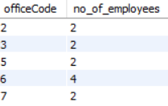
Identify the offices with less than a certain number of employees.
QUERY: SELECT officeCode , count(*) as no_of_employees
FROM employees OUTPUT
group by officeCode
having count(*) <5;
INTERPRETATION: Ientified the offices with less than 5 employees.
List offices along with their assigned territories.
QUERY: select * from offices
order by officeCode,territory;
INTERPRETATION: Identified the offices along with territories.

Slide 7
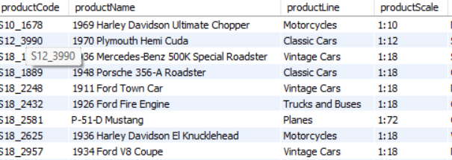
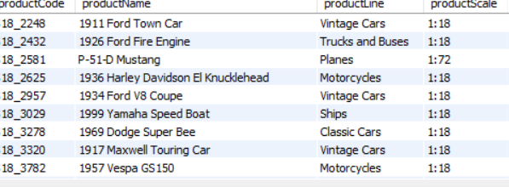
Find all products with a price above or below a certain amount (MSRP should be between 50 and 100)
QUERY: SELECT * FROM products
WHERE MSRP BETWEEN 50 AND 100;
INTERPRETATION: From that identified the products with price between 50 and 100.
OUTPUT

Slide 8

Retrieve the most expensive product based on MSRP.
QUERY:SELECT productLine,MSRP,productName OUTPUT
from products
order by 2 desc
limit 1;
INTERPRETATION: From that the most expensive product is classic car.
Calculate total sales for each product.
QUERY:
SELECT p.productCode,p.productName,p.productLine,SUM(od.quantityOrdered * od.priceEach) AS totalSalesFROM products p
JOIN orderdetails od ON p.productCode = od.productCode
GROUP BY p.productCode, p.productName,p.productLineORDER BY totalSales DESC;

Slide 9
ANALYTICS USING SQL
DATA - DRIVEN ANALYTICS PROJECT PART -2

Slide 10

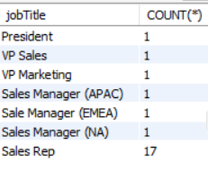
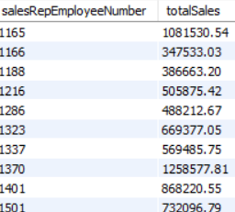
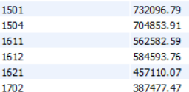
Find the total number of employees. OUTPUT
QUERY: SELECT COUNT(*) as total_employees
FROM employees;
INTERPRETATION: Identified the total employees. So total 23 employees.
Count the number of employees holding each job title. OUTPUT
QUERY: SELECT jobTitle,COUNT(*) FROM employees
GROUP BY jobTitle;
INTERPRETATION : Counted the employees holding each job title.
Calculate total sales generated by each sales representative
QUERY:SELECT salesRepEmployeeNumber,SUM(quantityOrdered * priceEach) AS totalSales from customers
join orders using(customerNumber)
join orderdetails using(orderNumber) OUTPUT
group by 1
order by 1;
INTERPRETATION: Calculated the total sales for each sales representative using join concept.

Slide 11
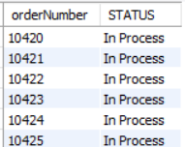
Identify orders that are still pending shipment (status = 'Pending’).
QUERY: SELECT orderNumber, STATUS FROM orders OUTPUT
WHERE STATUS = 'In Process’;
INTERPRETATION : Identified the orders using where clause
that are still pending.
List orders along with customer details.
QUERY: SELECT o.orderNumber, o.orderDate, o.requiredDate, o.shippedDate, o.status, c.customerNumber, c.customerName, c.contactLastName, c.contactFirstName, c.phone, c.addressLine1, c.addressLine2, c.city, c.state, c.postalCode, c.country FROM orders oJOIN customers c ON o.customerNumber = c.customerNumberORDER BY o.orderNumber;
INTERPRETATION: Identified the orders with customer details.

Slide 12
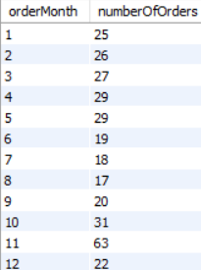
Find the average order amount for each customer
QUERY: SELECT customerName, AVG(quantityOrdered * priceEach) AS averageOrderAmount
FROM customers JOIN orders using(customerNumber)
JOIN orderdetails using(orderNumber)
GROUP BY customerName;
INTERPRETATION: From that Identified the average amount of a each customer with the help of average function.
Find the number of orders placed in each month.
QUERY: SELECT MONTH(orderDate) AS orderMonth , COUNT(orderNumber) AS numberOfOrders
FROM orders
GROUP BY MONTH(orderDate); OUTPUT
INTERPRETATION: Identified the no of orders placed in each
month .And in the month of 11 more orders are placed.

Slide 13


Find the highest-value order based on total sales
QUERY: select o.ordernumber,sum(od.quantityordered * od.priceeach) as totalsales from orders o join orderdetails od on o.ordernumber = od.ordernumber
group by o.ordernumber OUTPUT
order by totalsales desc
limit 1;
INTERPRETATION: From that identified the highest value order of total sales. And highest value is 67392.85 for ordernumber is 10165.
List the most frequently ordered products
QUERY:SELECT p.productName, COUNT(od.productCode) AS orderCountFROM orderdetails od JOIN products p ON od.productCode = p.productCode
GROUP BY p.productName OUTPUT
ORDER BY orderCount DESC
Limit 1;
INTERPRETATION: From that the most frequent order product is

Slide 14

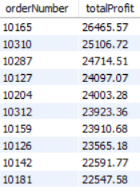
Identify orders with delayed shipping (shippedDate > requiredDate
QUERY: SELECT orderNumber from orders OUTPUT
where shippedDate>requiredDate;
INTERPRETATION: From that the order number 10165 is identified as delayed shipping order
Calculate revenue for each order and identify the top 10 most profitable
QUERY: SELECT od.orderNumber,SUM(od.quantityOrdered * (od.priceEach - p.buyPrice))
AS totalProfit FROM orderdetails od OUTPUT
JOIN products p ON od.productCode = p.productCode
GROUP BY od.orderNumber
ORDER BY totalProfit DESC
LIMIT 10;
INTERPRETATION: From that identified the top 10 most profitable orders.

Slide 15
CONCLUSION:
SPRINT 9
The analysis provides detailed view of customers and offices and product data.It identifies the top customers by credit limit and average credit limit for each country
And also those who have exceeded the credit limit , retrieved the most payment details of customers and also retrieves office performance based on employees and determined price of products and total sales.
SPRINT 10
The analysis provides detailed view of employee and order data.It identifies the total number of employees and listed the count of categories and listed basic details of customers and order and identified the orders whether delivered or not and highest orders and identified the most profitable orders.

Slide 16
THANK YOU

